Slide 1
Capital Projects Update

Slide 2
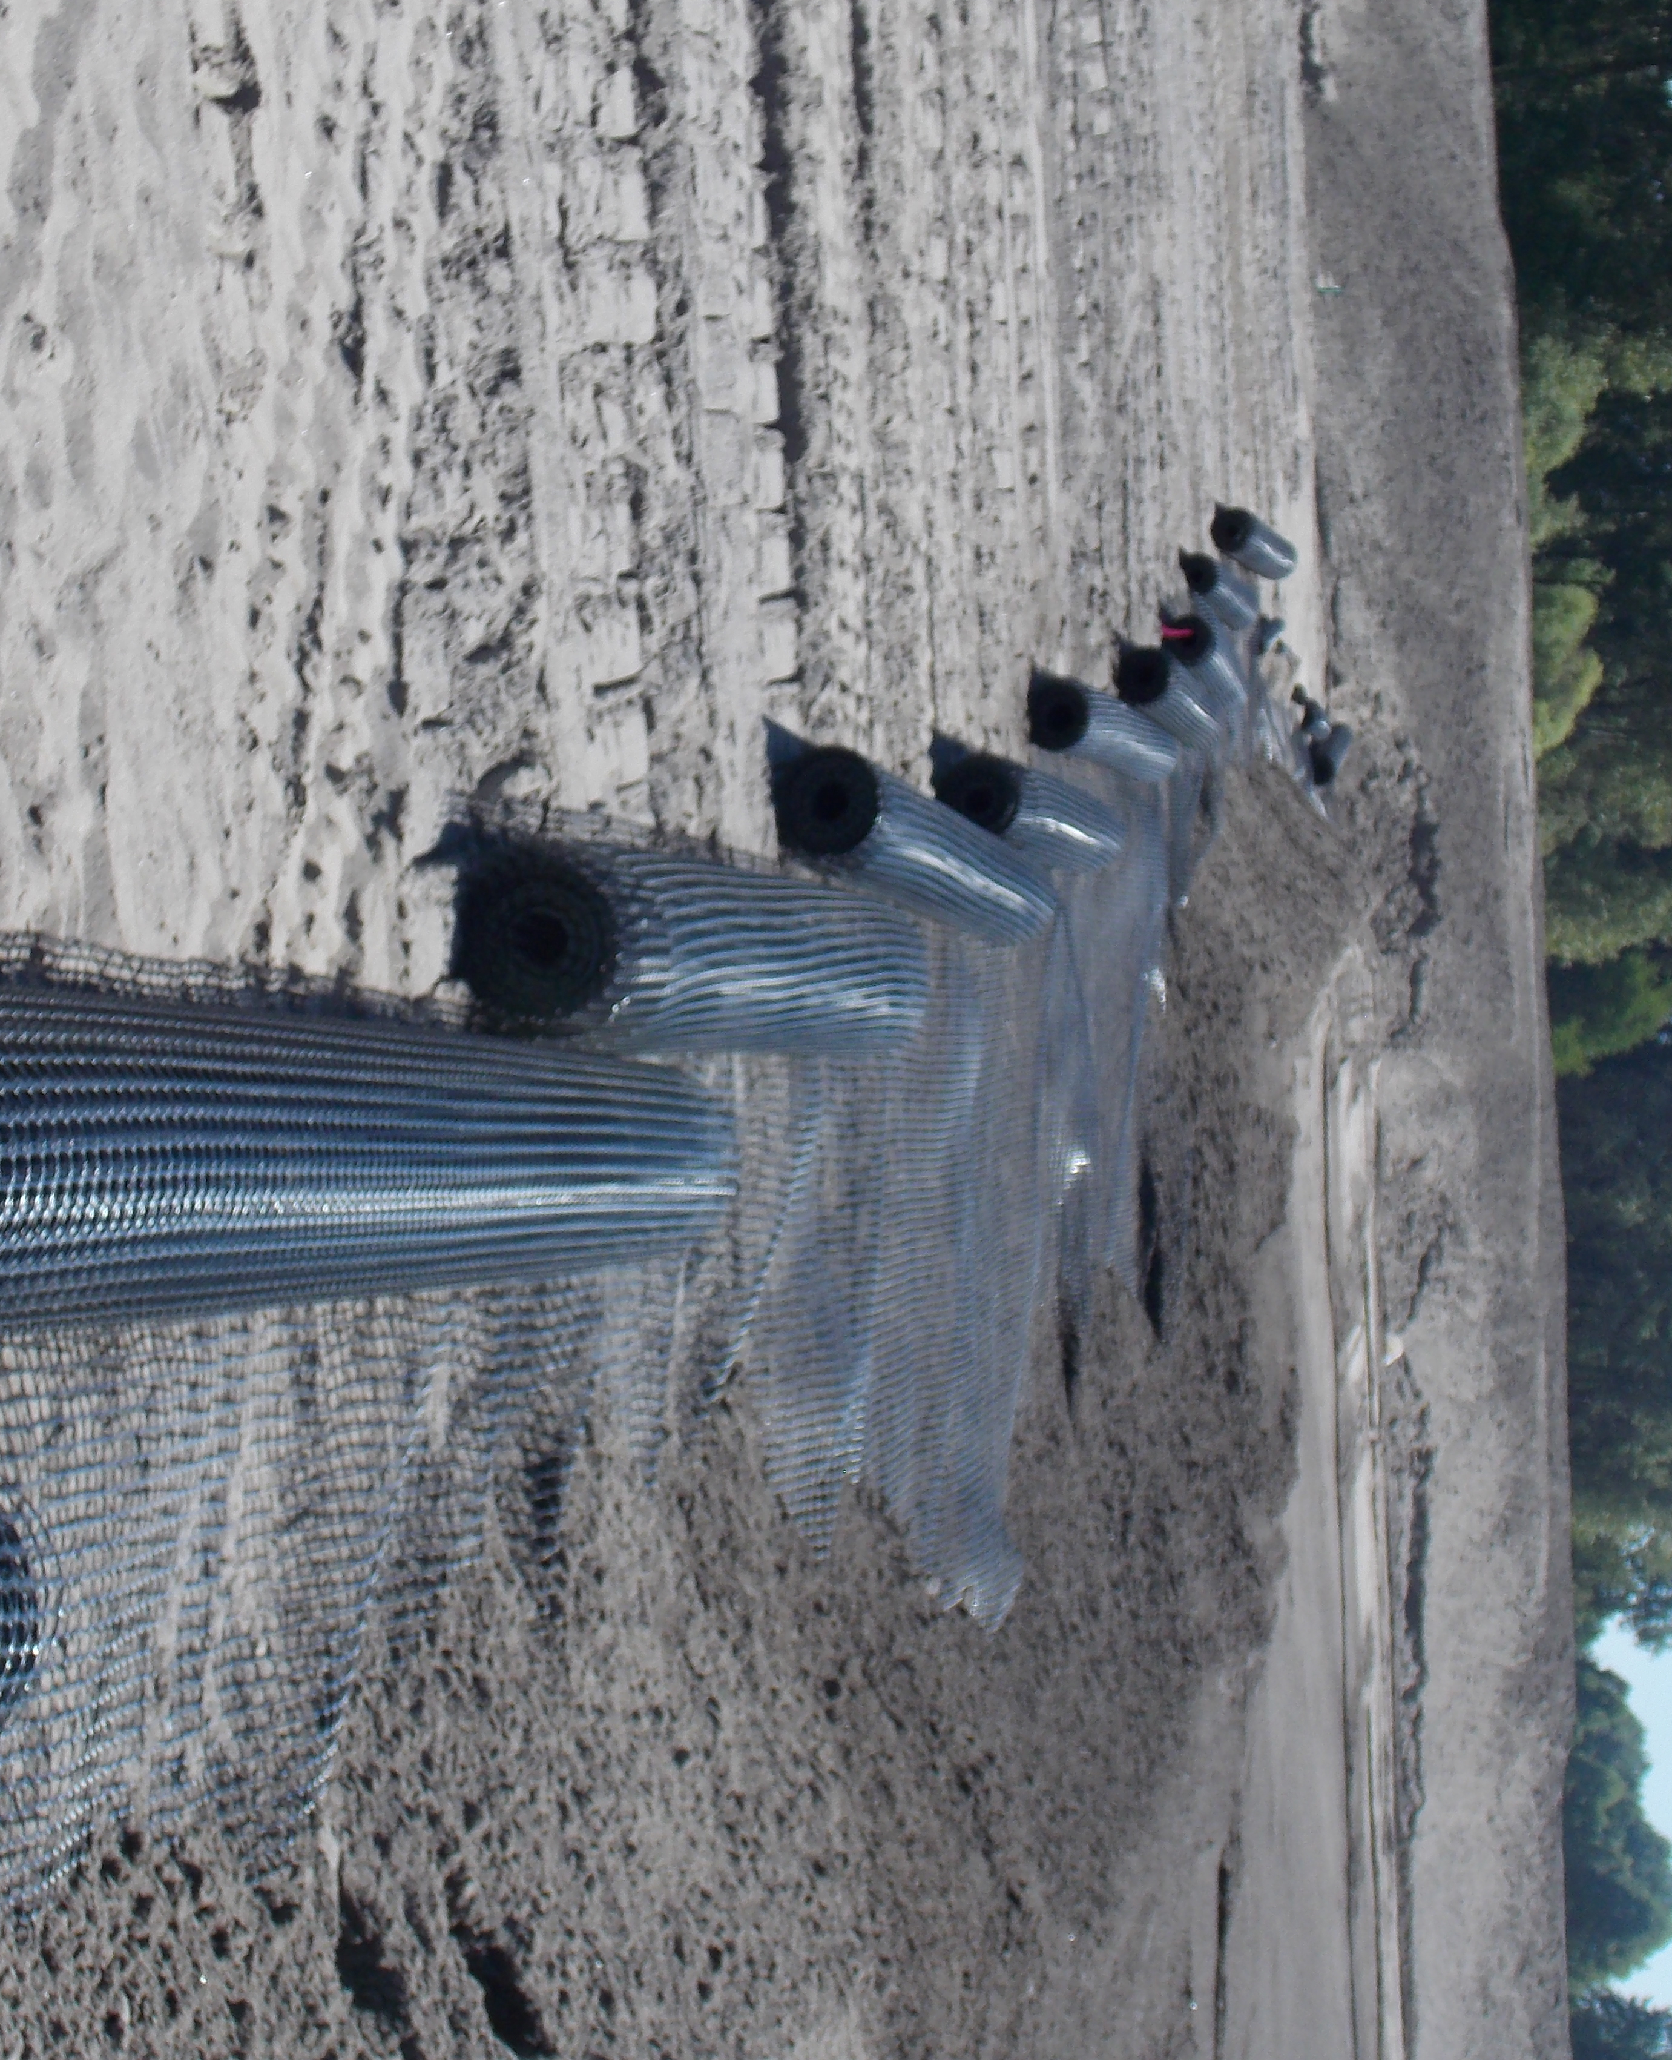
“Geo-Grid” Fabric

Slide 3
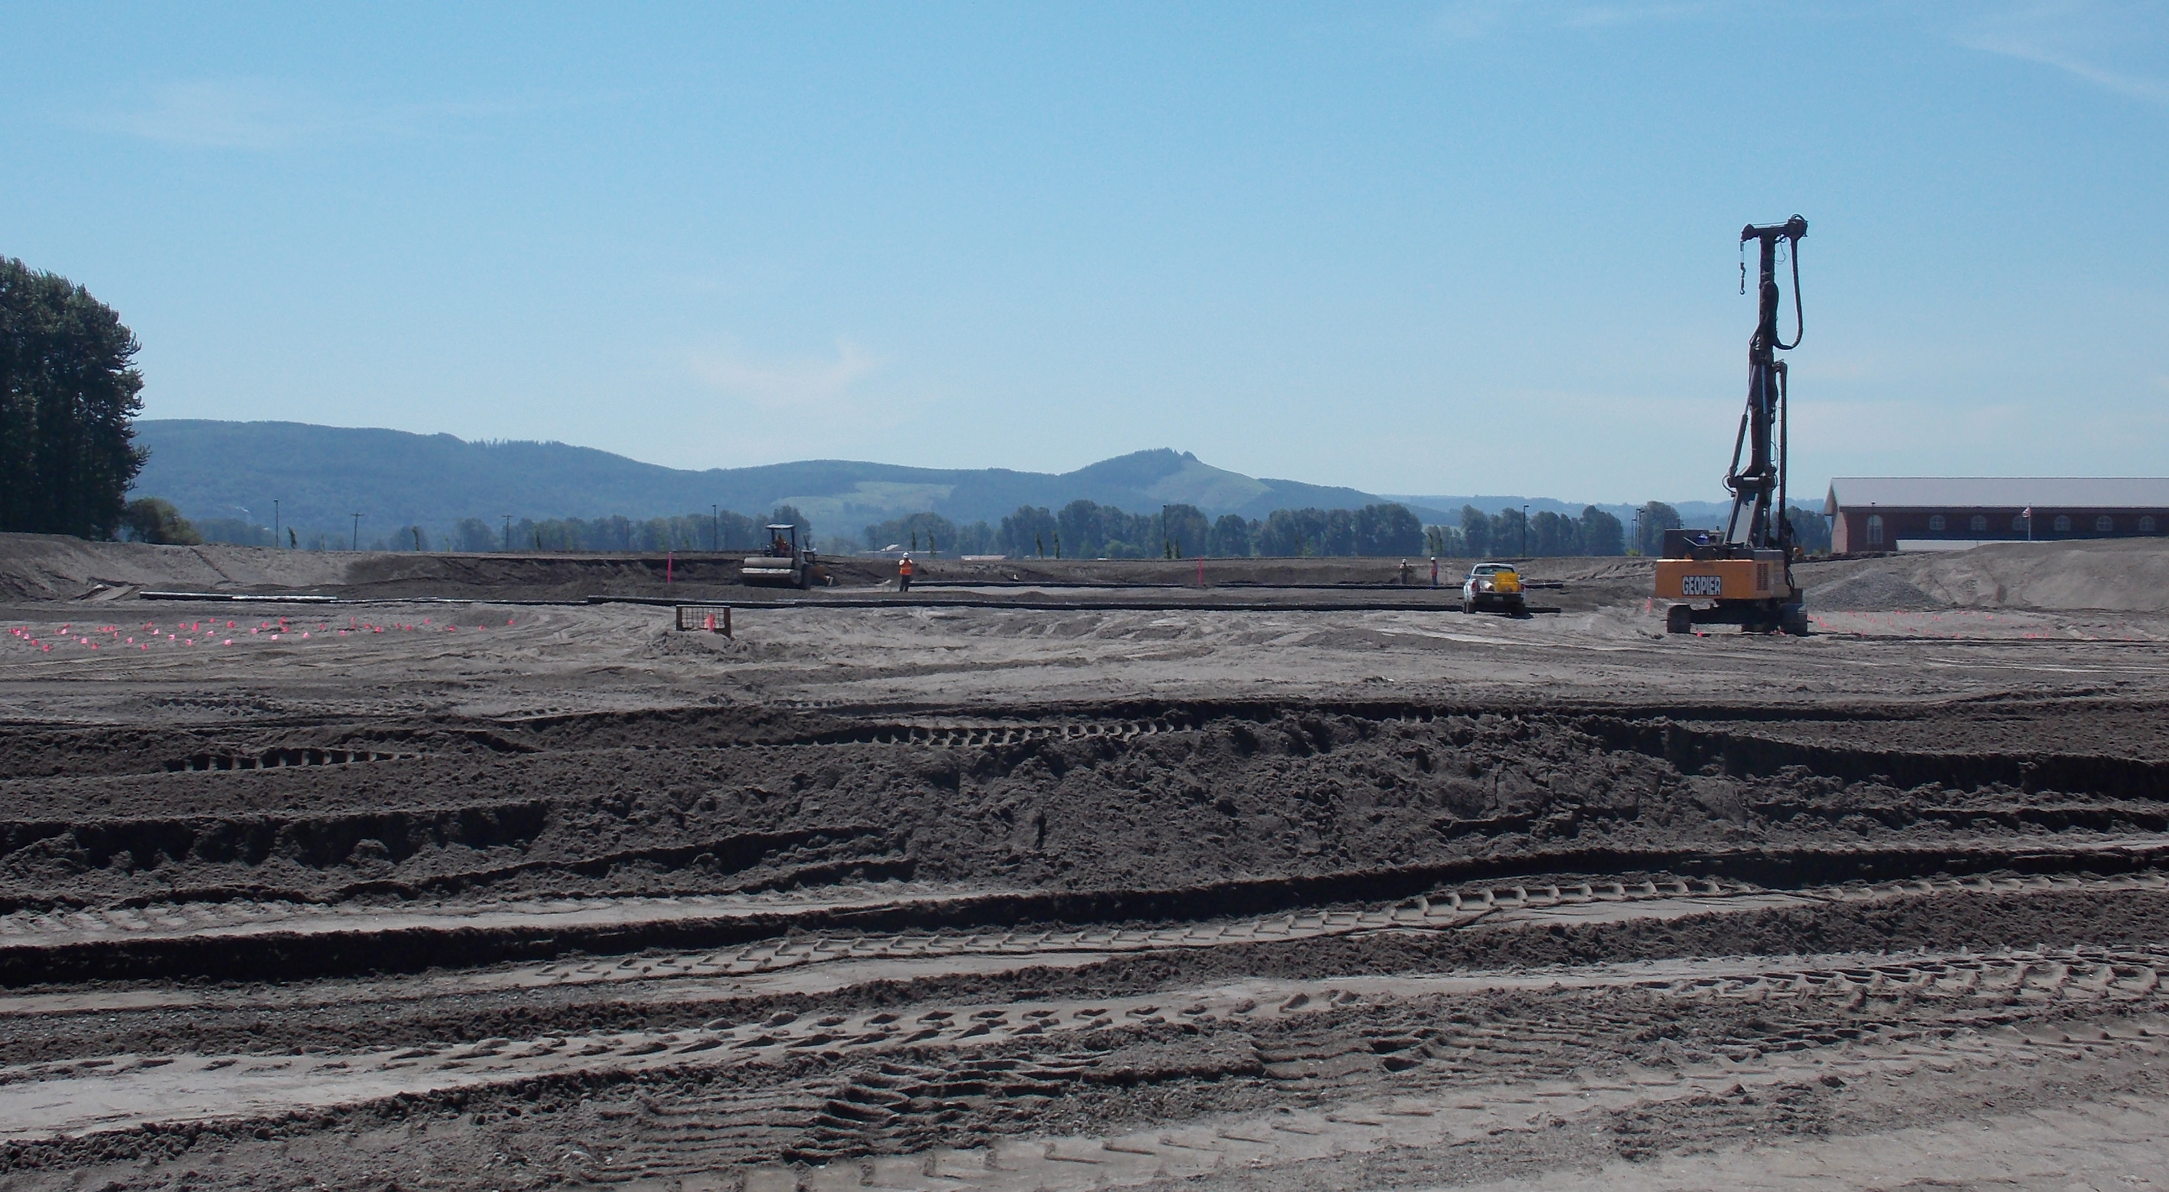
“RAP” and “Geo-Grid”

Slide 4
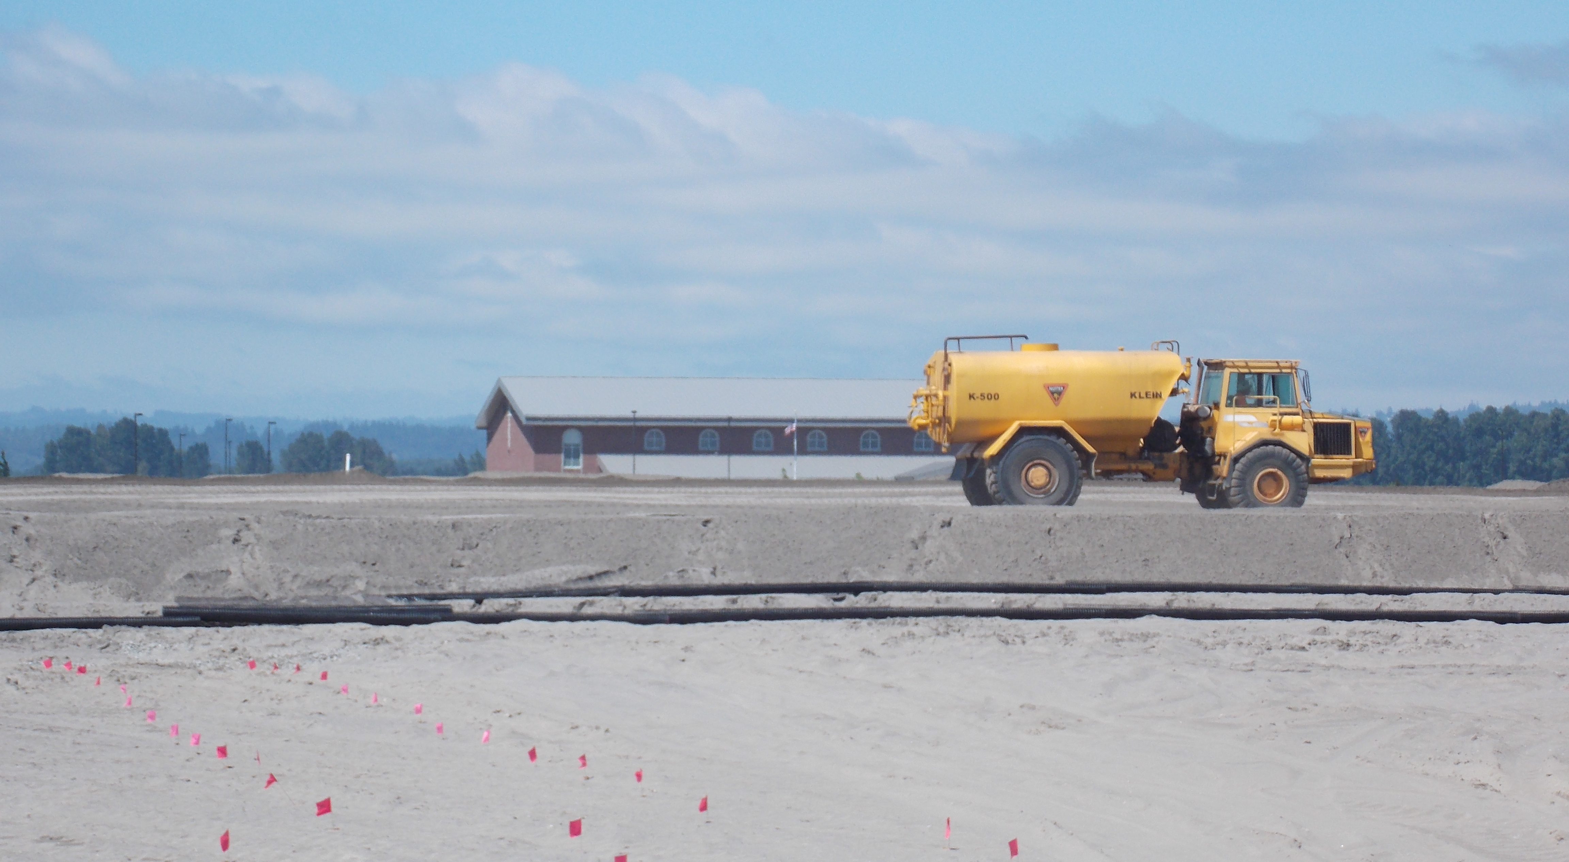
Finished Floor Height

Slide 5
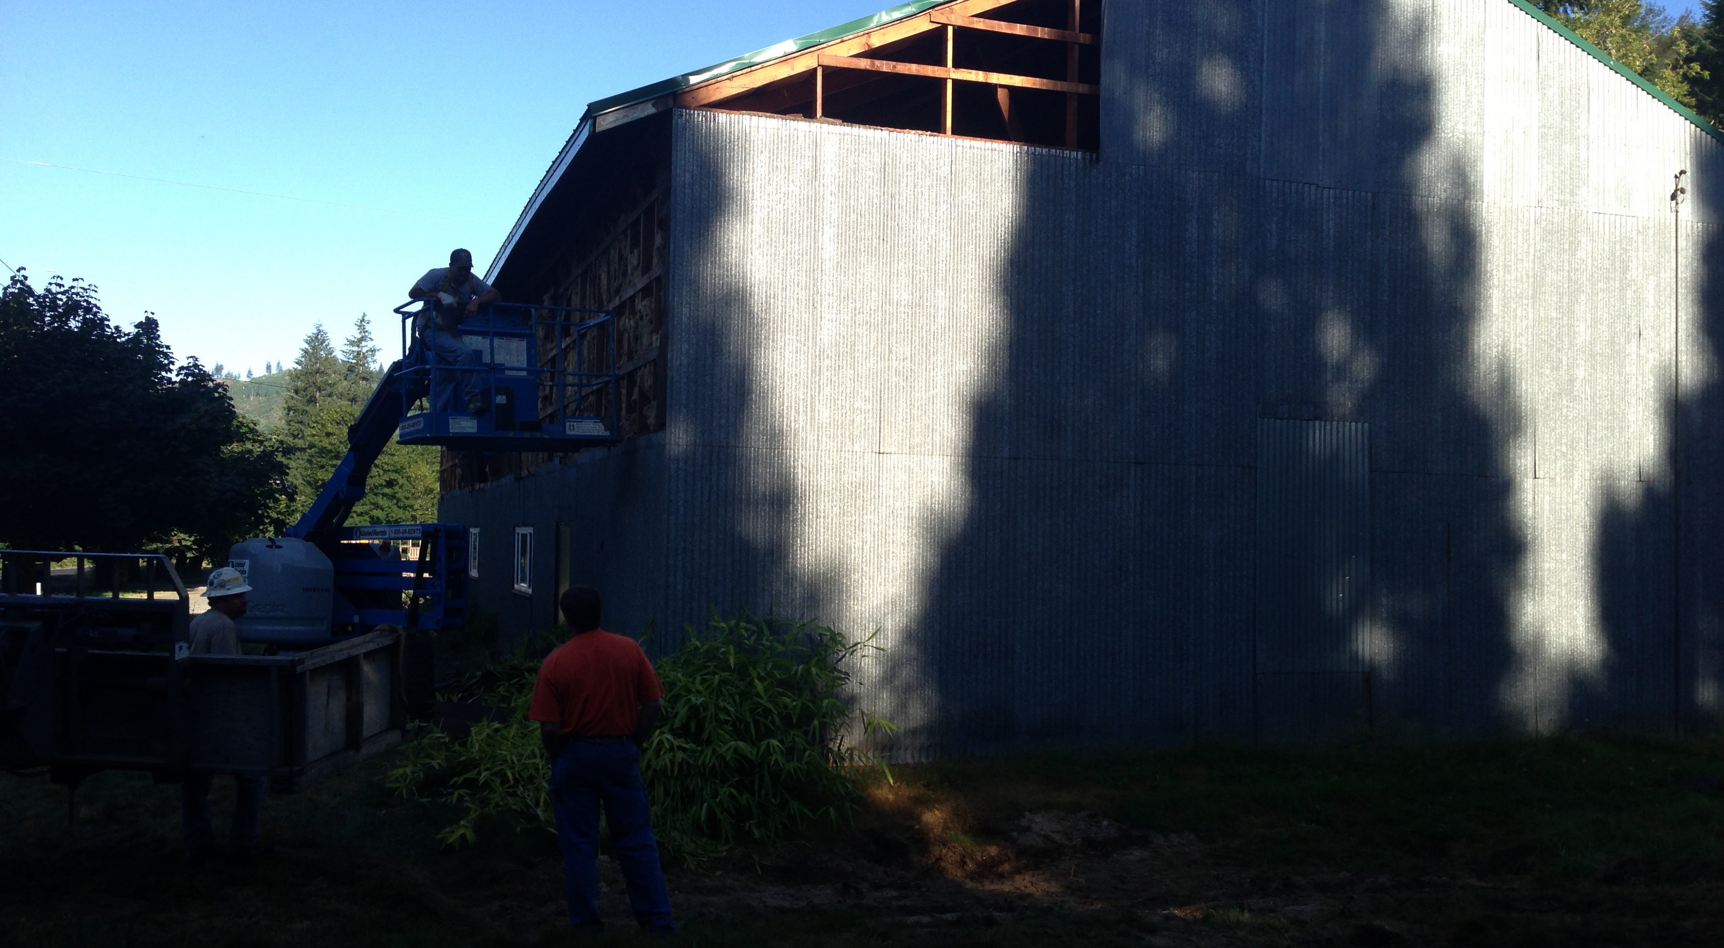
Initial Demolition Stages

Slide 6
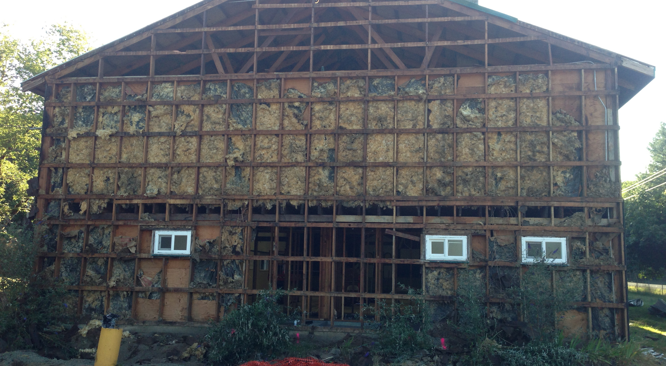
West Side of Gym

Slide 7
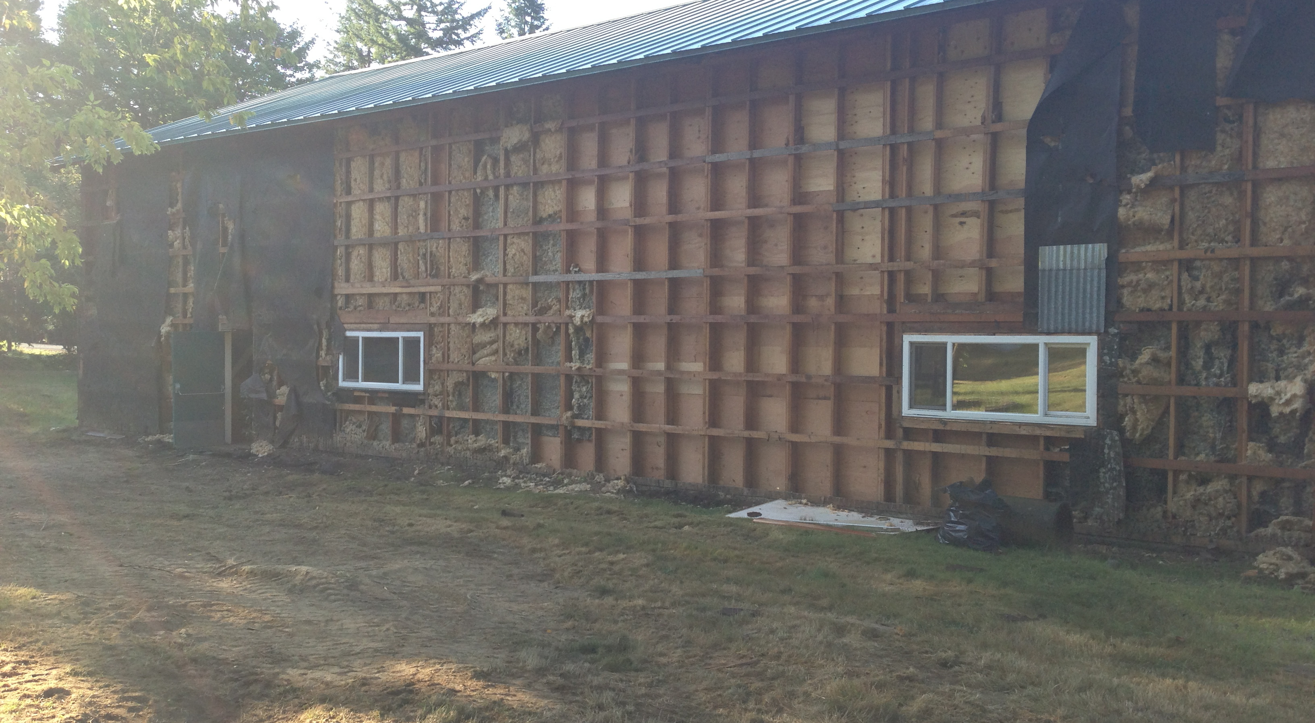

Slide 8
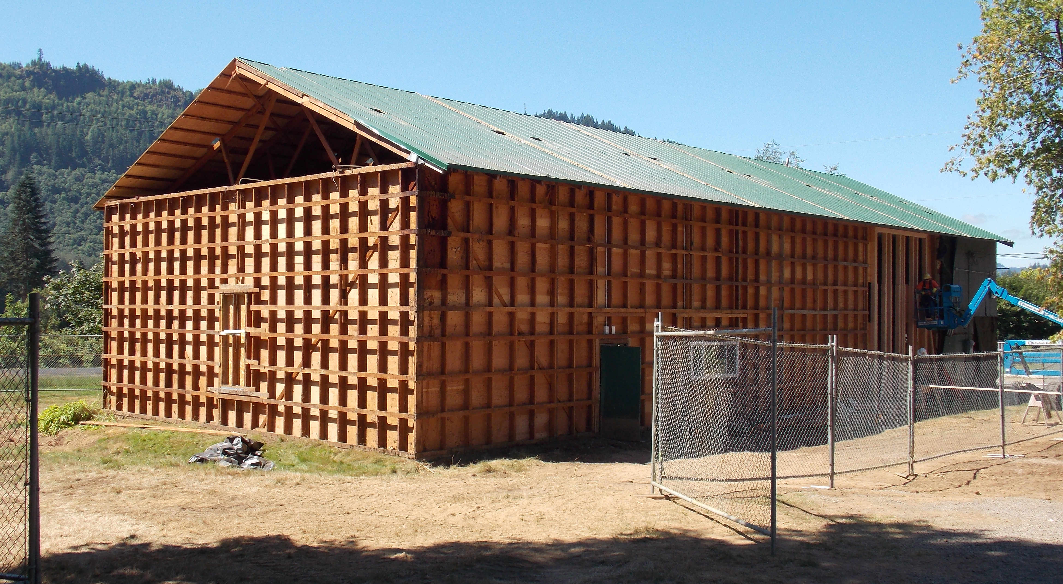
Siding and Insulation Stripped

Slide 9
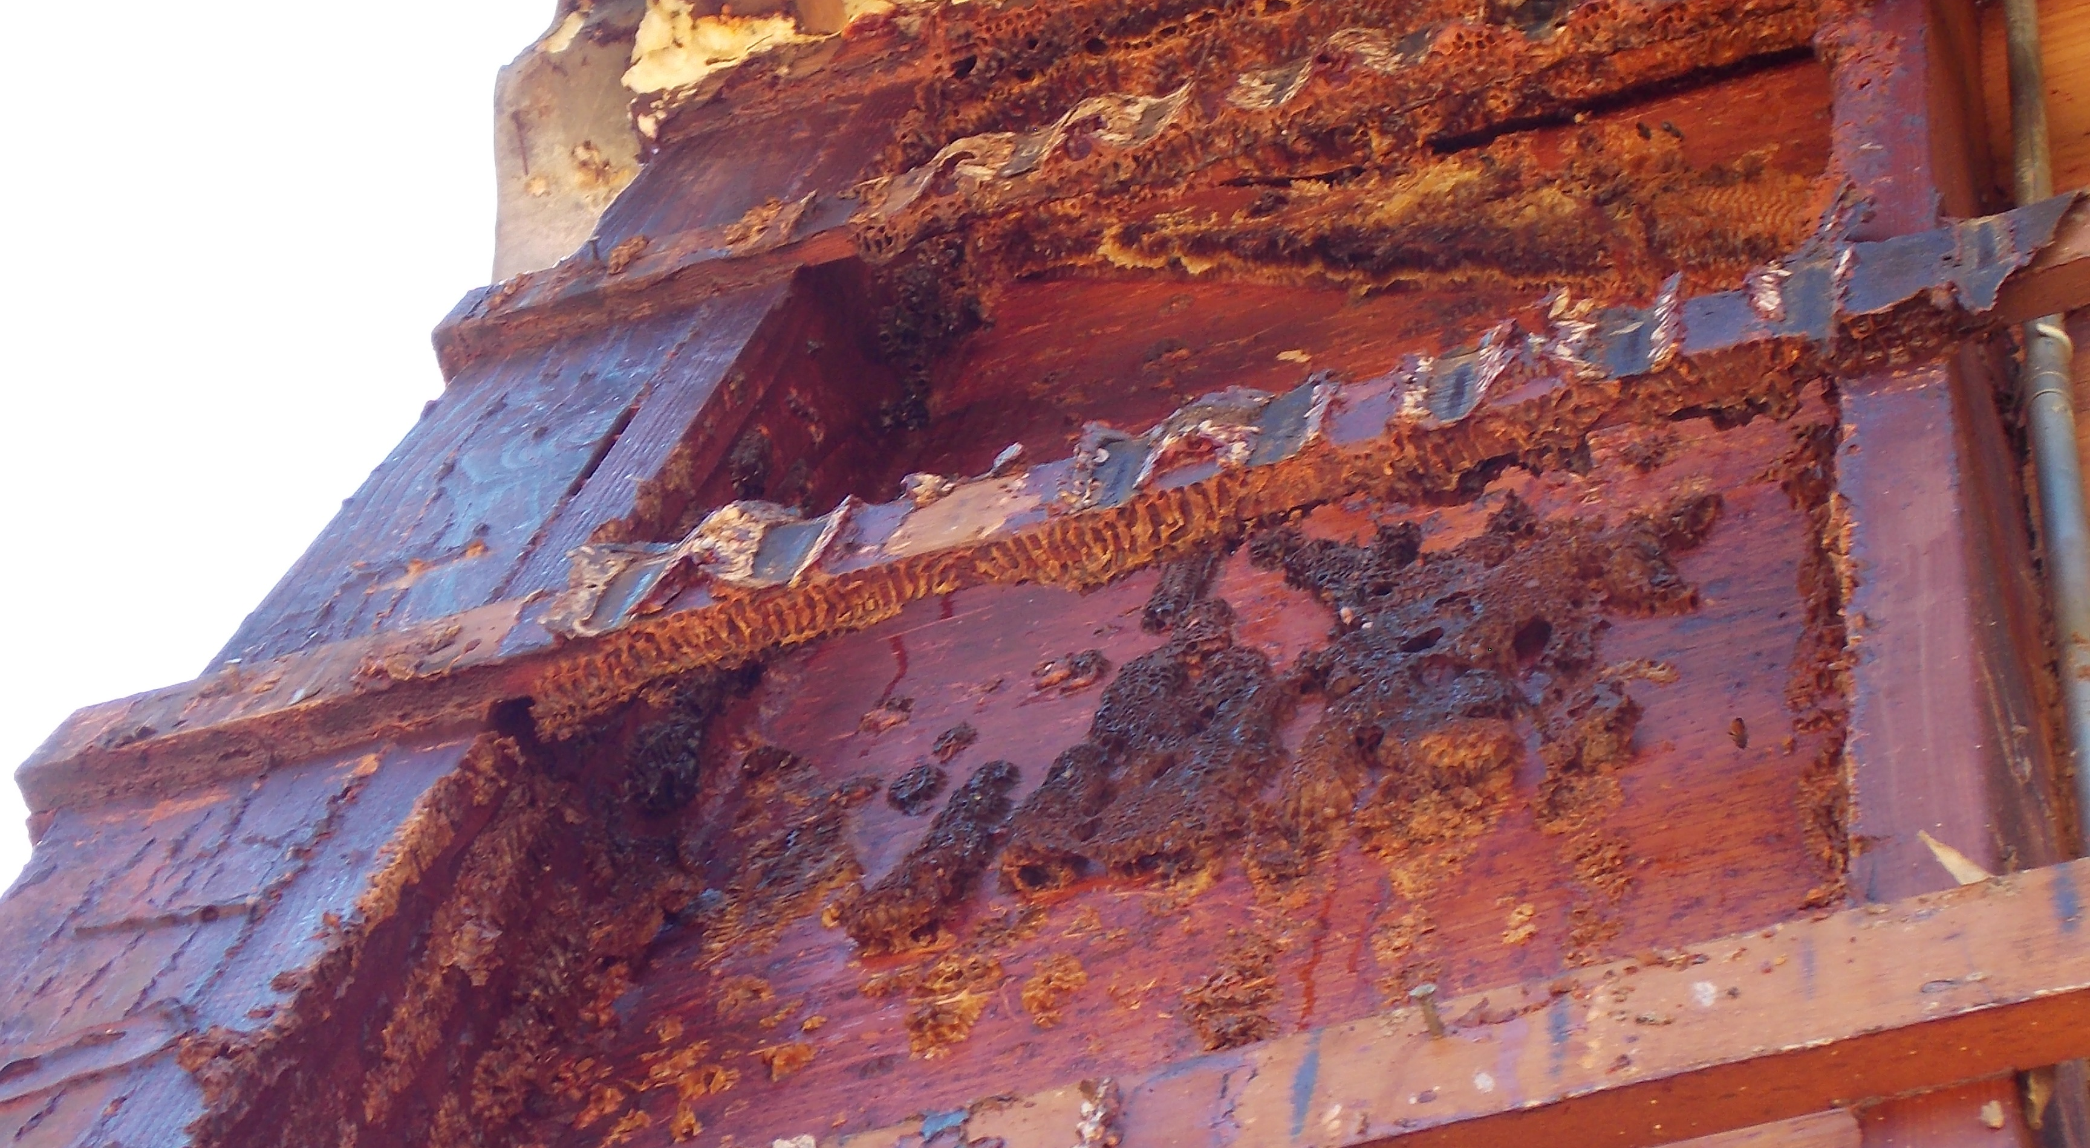
Bee Hive

Slide 10
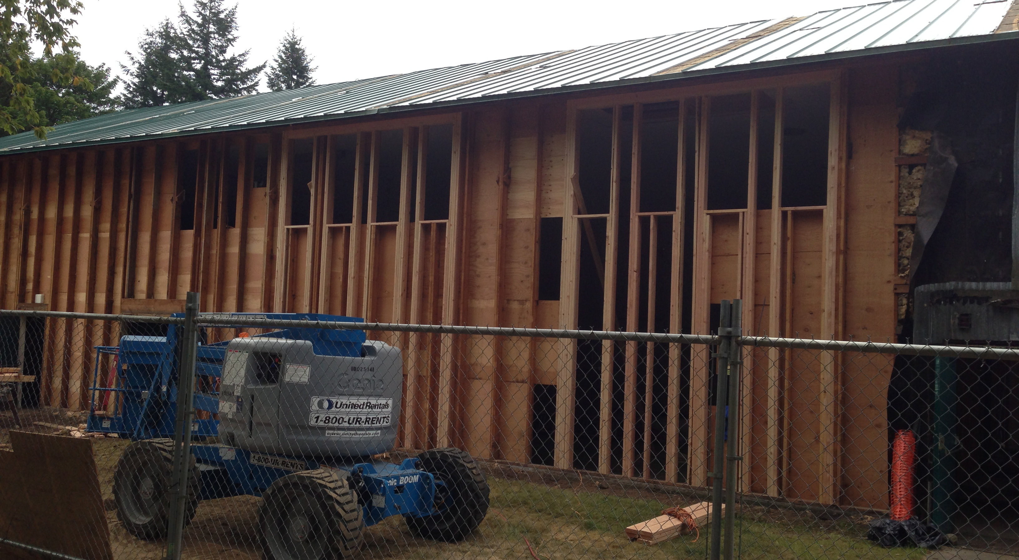
Clerstories Framed

Slide 11
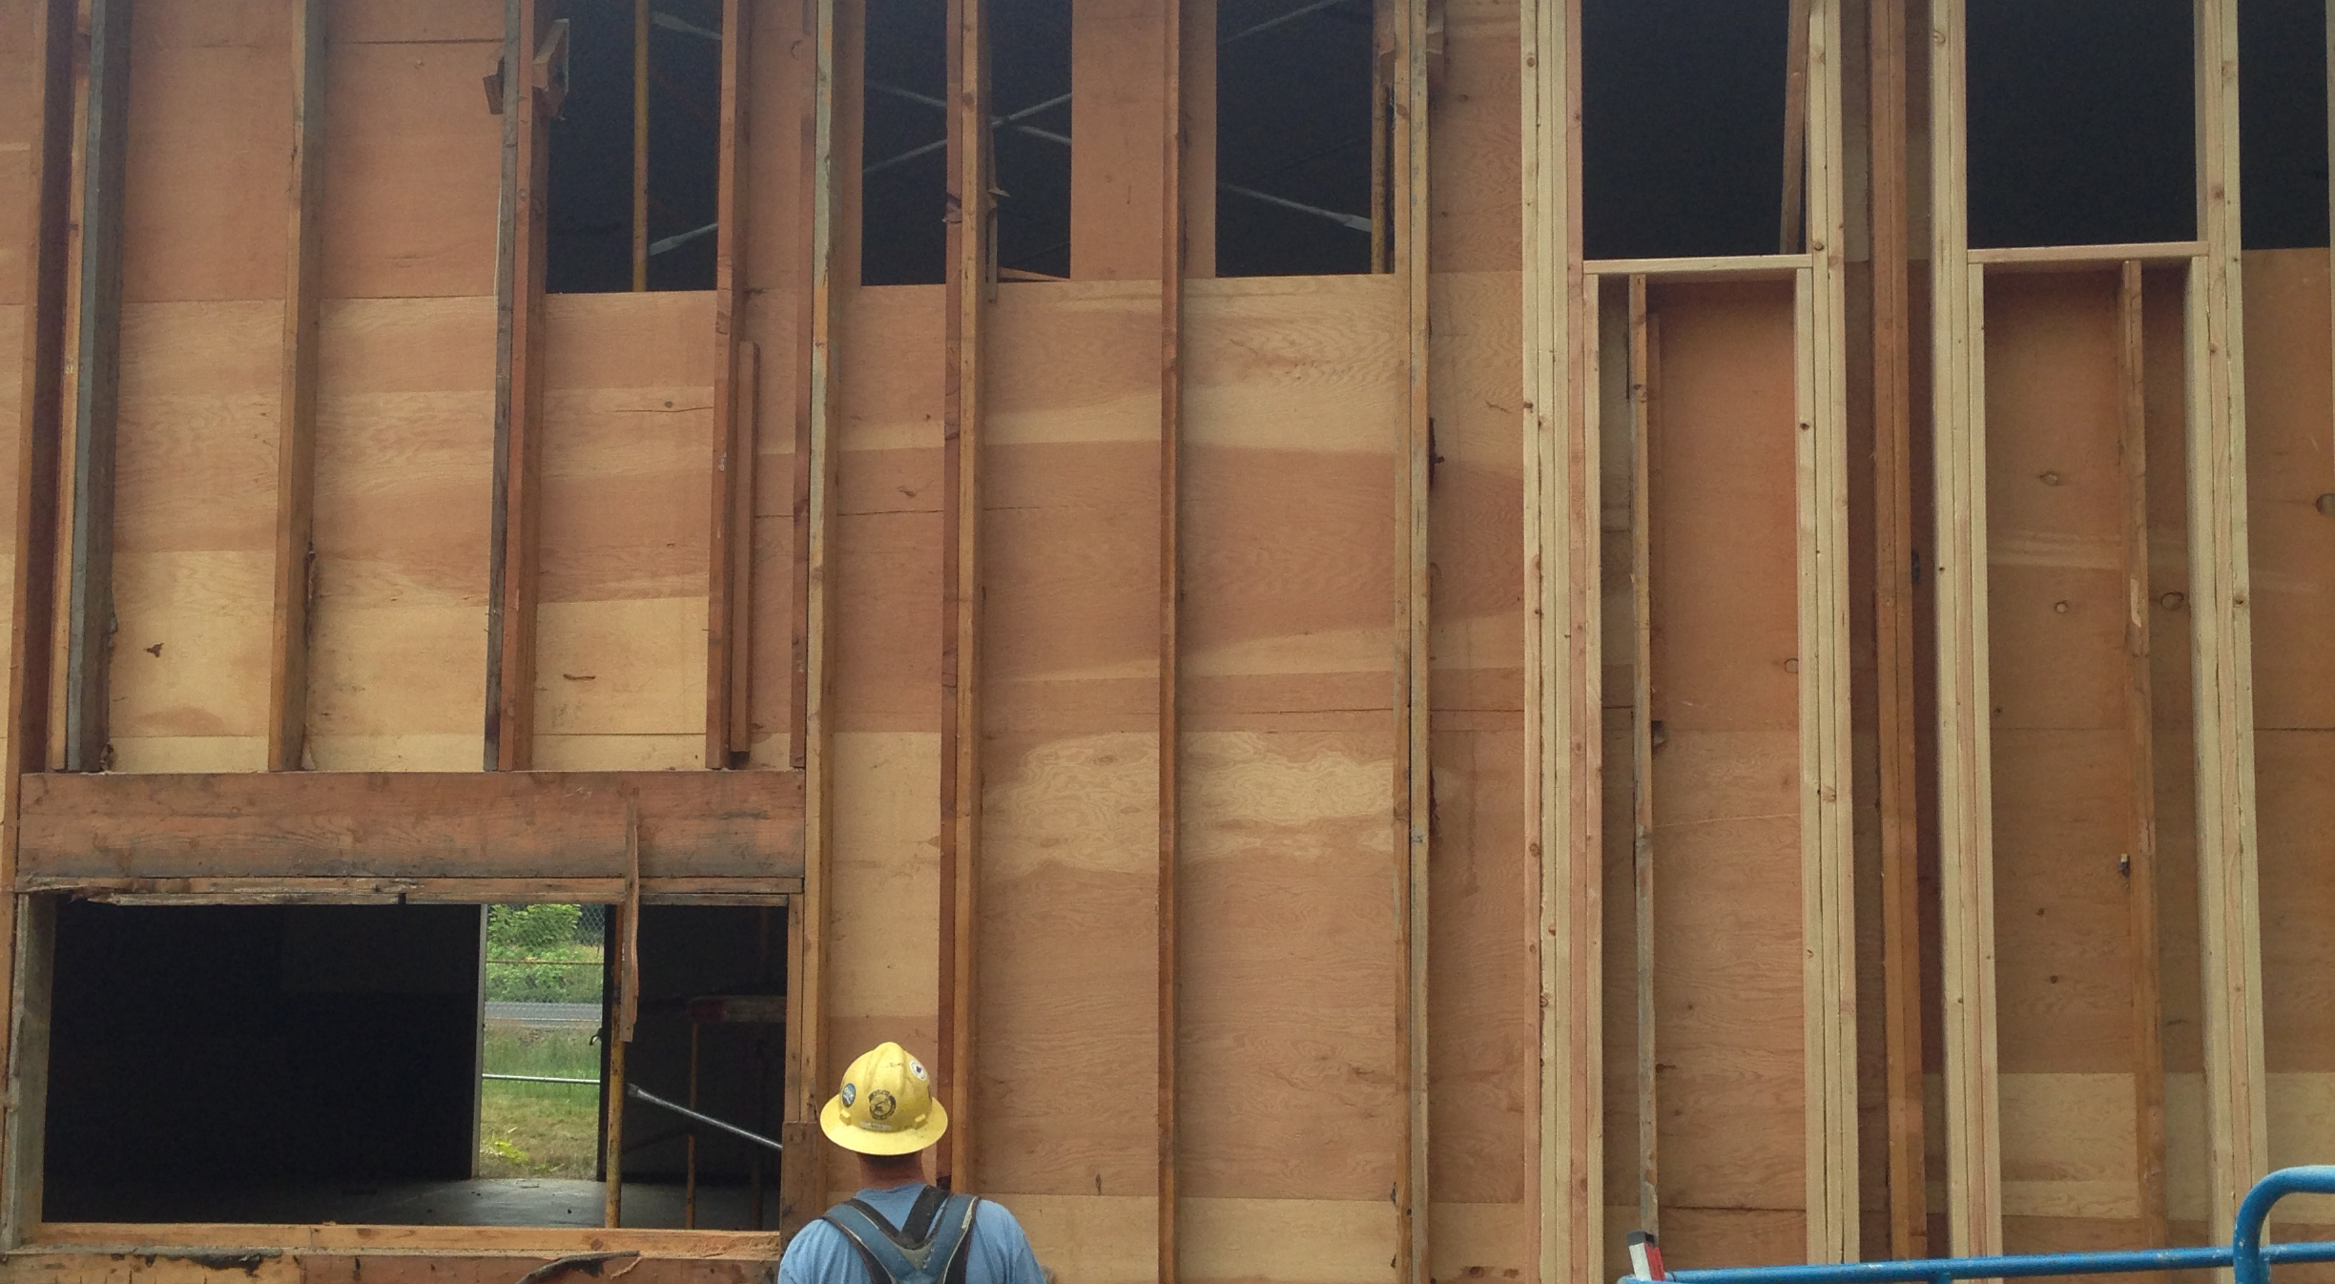

Slide 12
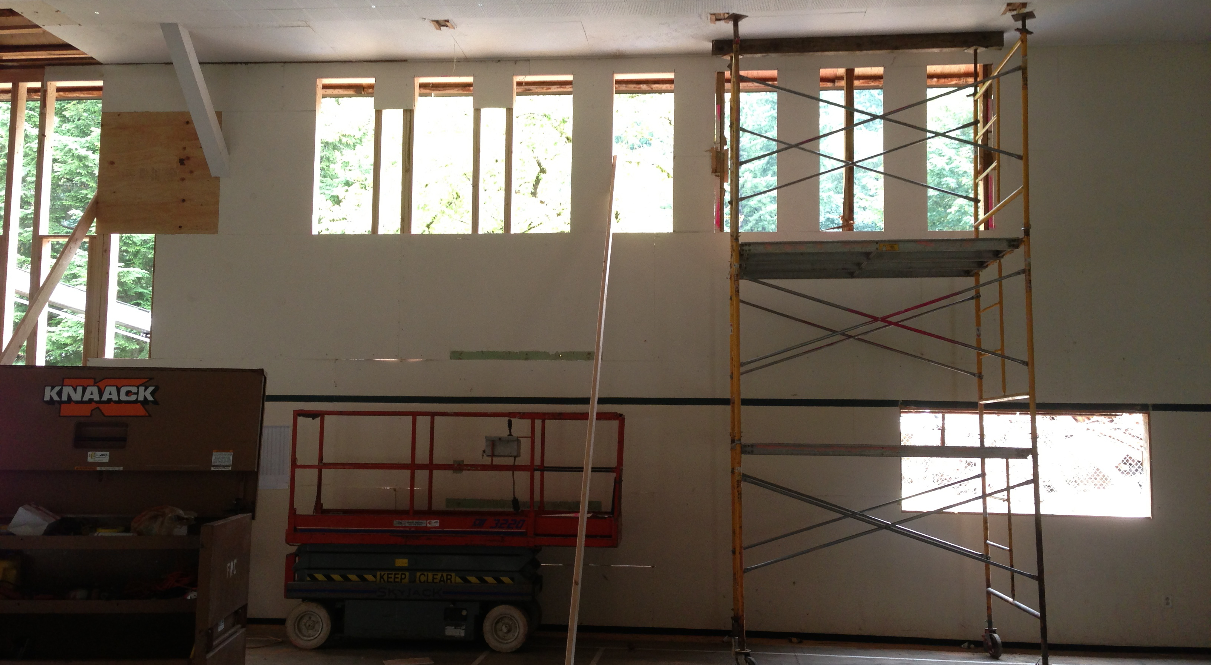

Slide 13
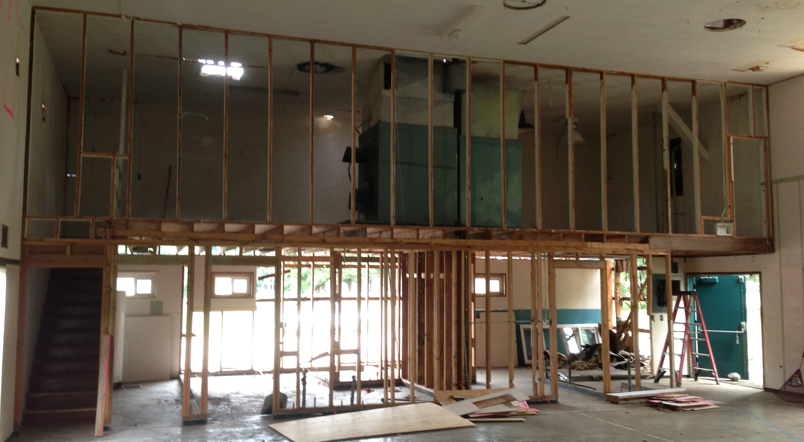
Interior, West End

